Slide 1
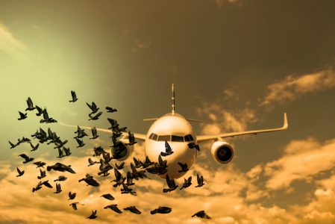
Data Visualization of Bird Strikes between 2000-2011

Slide 2
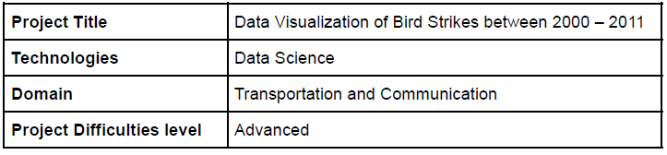
Project Detail

Slide 3
Background
Transport and communication are in the crucial domain in the field of analytics.
Environmental impacts and safety are, nowadays, two major concerns of the scientific
community with respect to transport scenarios and to the ever-growing urban areas.
These issues gain more importance due to the increasing amount of vehicles and
people. Seeking new solutions is reaching a point where available technologies and
artificial intelligence, especially MAS, are being recognized as ways to cope with and
tackle these kinds of problems in a distributed and more appropriate way.
A bird strike is strictly defined as a collision between a bird and an aircraft which is in
flight or on a take-off or landing roll. The term is often expanded to cover other wildlife
strikes - with bats or ground animals. Bird Strike is common and can be a significant
threat to aircraft safety.
Bird strikes may occur during any phase of flight, but are most likely during the
take-off, initial climb, approach and landing phases due to the greater numbers of birds
in flight at lower levels. To have a closer look the following document visually depicts
the data collected on Bird Strikes by FAA between 2000-2011.

Slide 4

Problem Statement
The goal of this project is to analyse the bird strike incidents happened between 2000-2011. To achieve the goal, we used a data set that is collected by FAA during 2000-2011. The objective of the project is to perform data visualization techniques to understand insights of the data. This project aims apply various Business Intelligence tools such as Tableau or Power BI to get a visual understanding of the data.

Slide 5
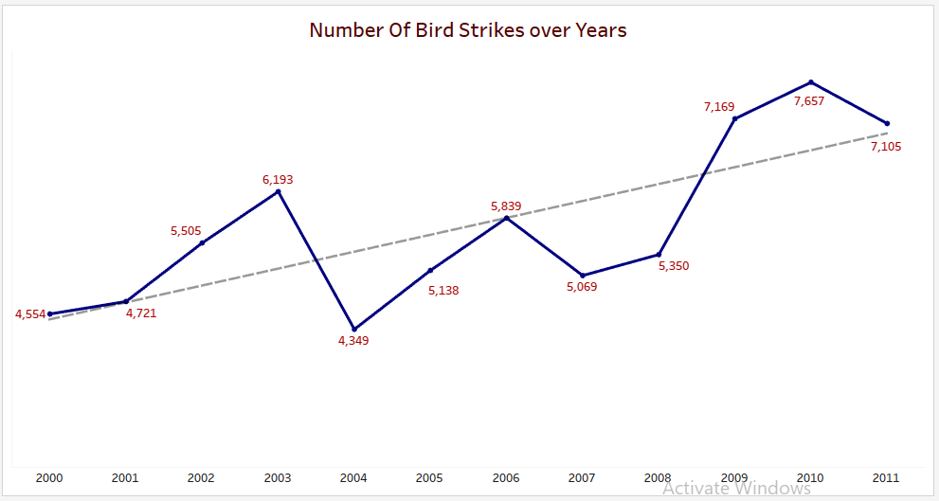
Insights

Slide 6
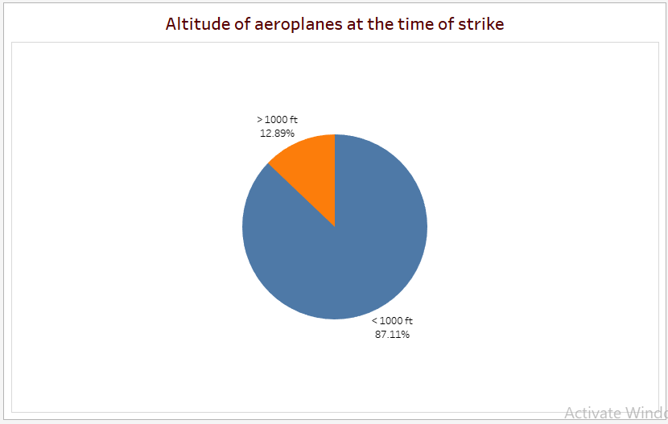
Altitude of aeroplanes at the time of strike

Slide 7
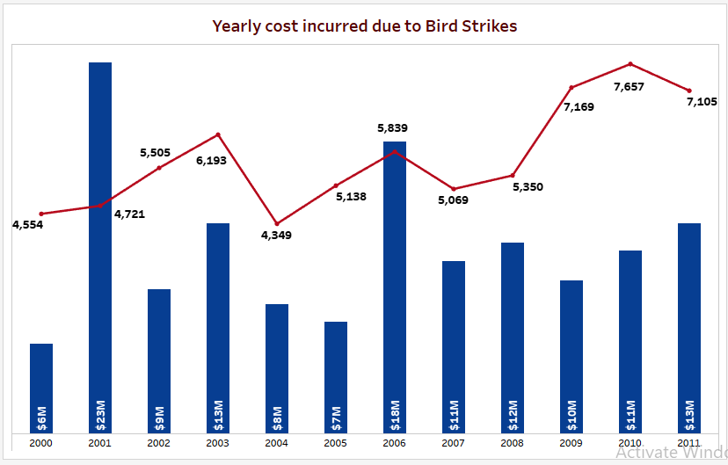
Yearly cost incurred due to Bird Strikes

Slide 8
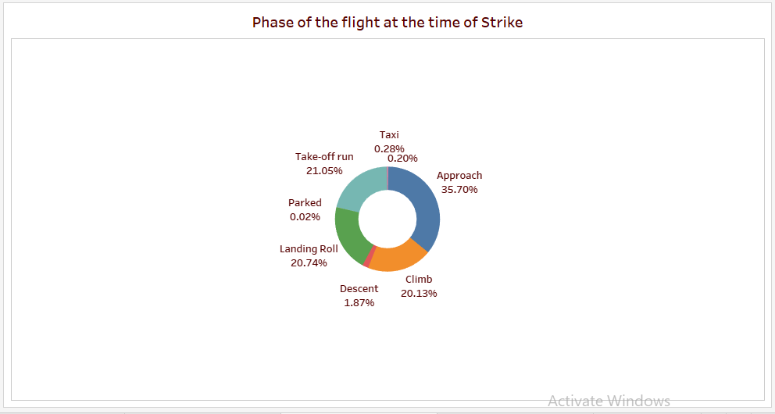
Phase of the flight at the time of Strike

Slide 9
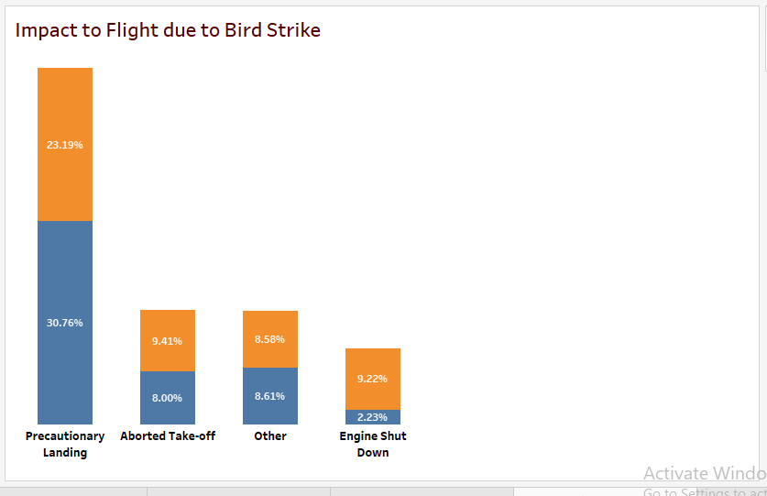
Impact to Flight due to Bird Strike

Slide 10
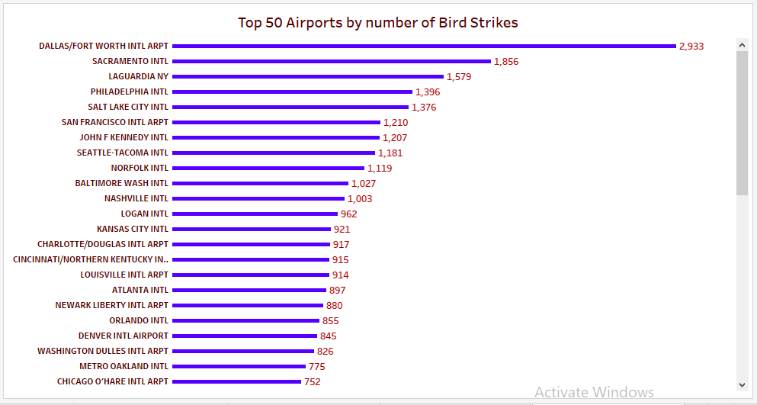
Top 50 Airports by number of Bird Strikes

Slide 11
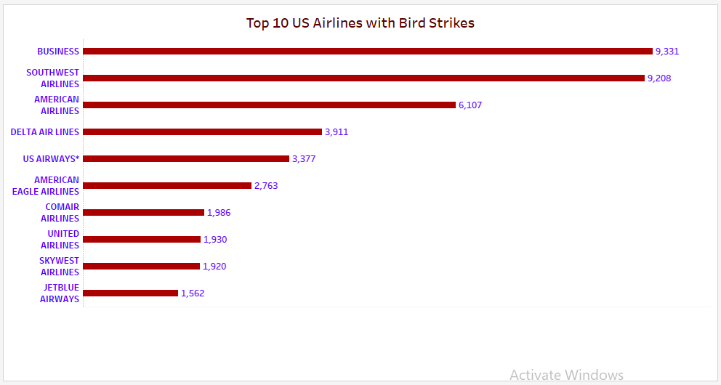
Top 10 US Airlines with Bird Strikes

Slide 12
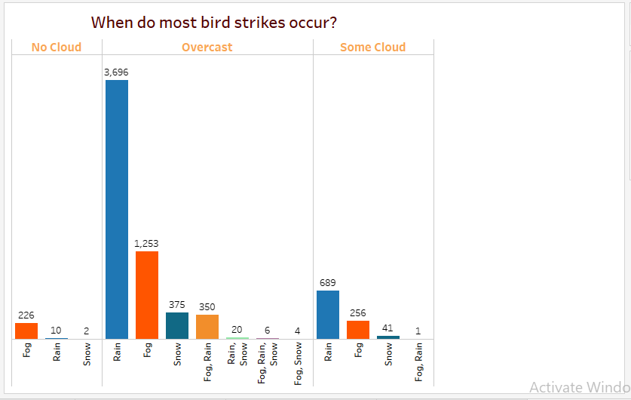
When do most bird strikes occur?

Slide 13
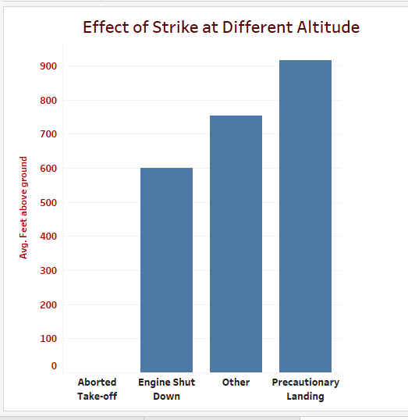
Effect of Strike at Different Altitude

Slide 14
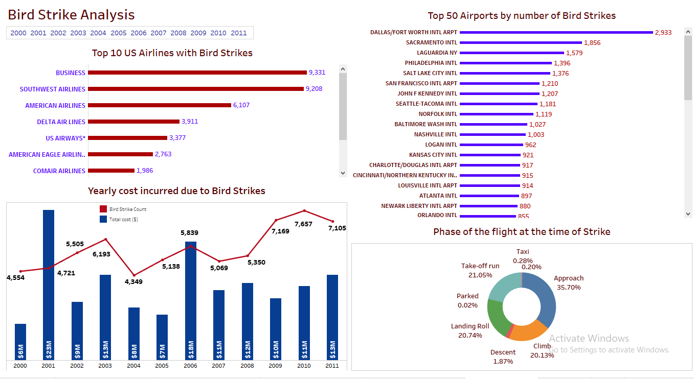

Slide 15
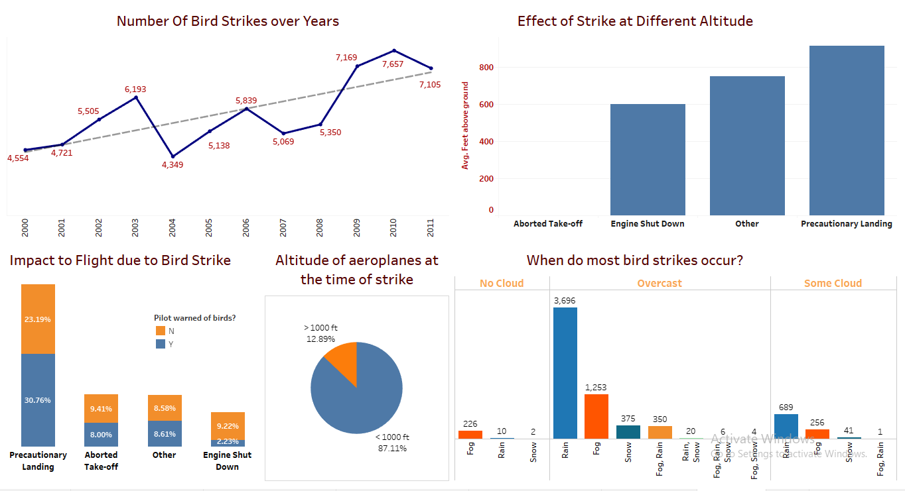

Slide 16
Conclusion
Most of the bird strike incidents has been occurred while raining in Cloudy & Overcast weather
Prior warning to the pilot reduces the risk of damage to the aircraft
Highest cost($23M) incurred in the year 2001 due to bird strike
In 53.95% incidents Precautionary Landing had been done while in 17.41% incidents, the take off has been aborted
Bird Strikes Incidents have an upward trend and 2010 has the highest number of Bird Strike incidents. In 2001, Highest cost has been incurred due to Strike incidents
Most of the incidents have reported on DALLAS/FORT WORTH International Airport
87.11% bird strike incidents has been reported at the height less than 1000ft.

